Slide 1

User awareness programme about N-List Consortia
By
Shalendra Singh Kushwah
Librarian

Slide 2
About N-List
"National Library and Information Services Infrastructure for Scholarly Content (N-LIST)", being jointly executed by the e-ShodhSindhu Consortium, INFLIBNET Centre and the INDEST-AICTE Consortium.
The N-LIST project provides access to e-resources to students, researchers and faculty from colleges and other beneficiary institutions through server(s) installed at the INFLIBNET Centre.
The authorized users from colleges can now access e-resources and download articles required by them directly from the publisher's website.

Slide 3
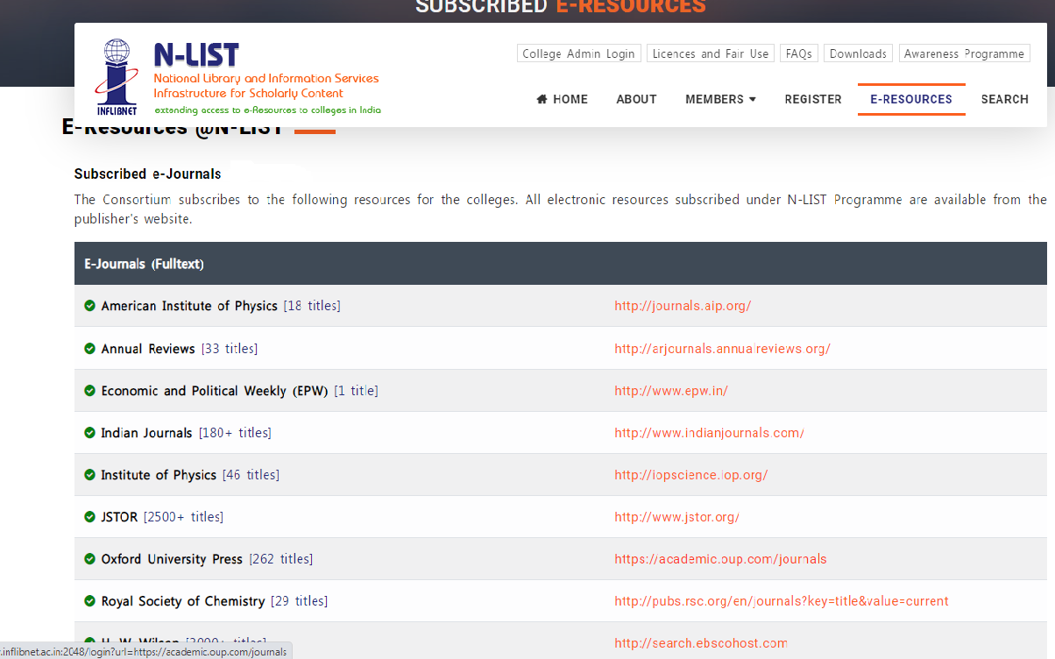
Resources ? Here Some E-Journals

Slide 4
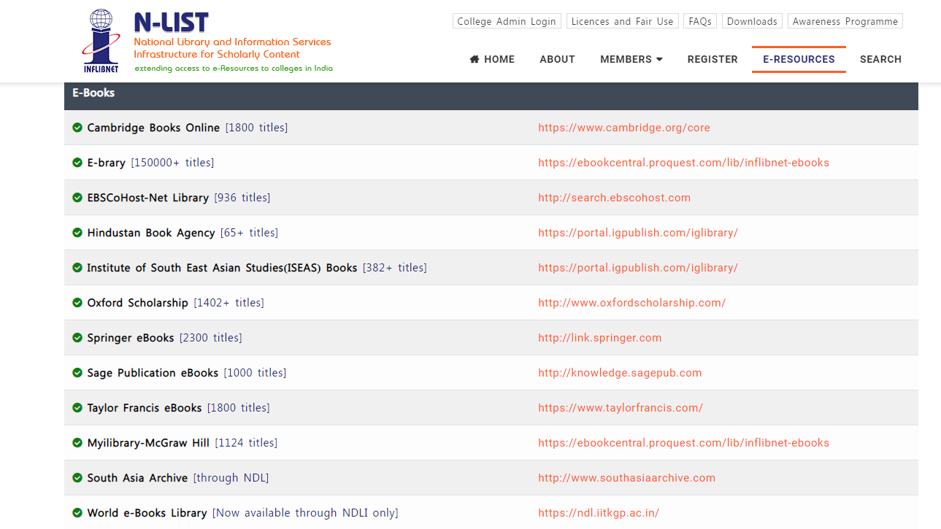
Resources ? Here Some E-Books

Slide 5
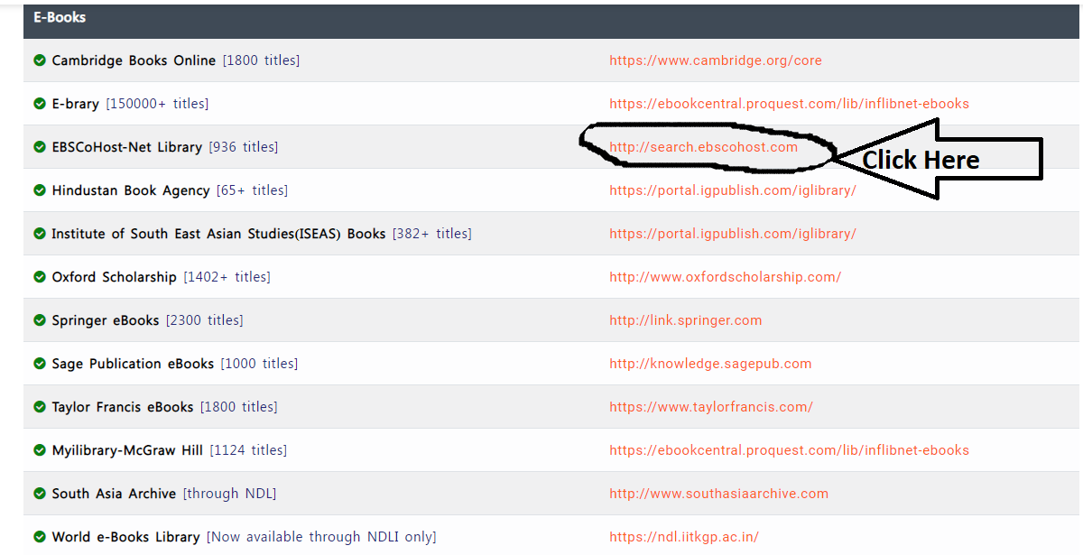
How to Access Information-1

Slide 6
Or you can Click Here

Slide 7
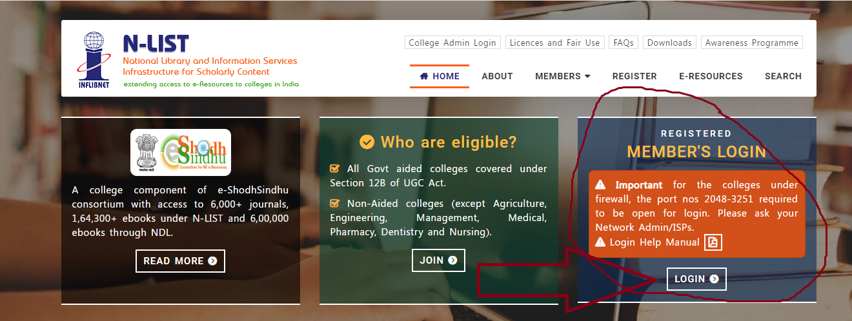
How to Access Information-2

Slide 8
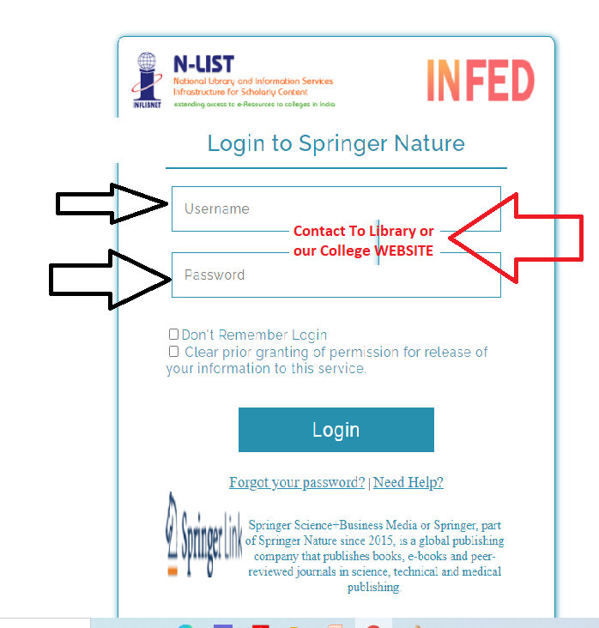
How to Access Information-3

Slide 9
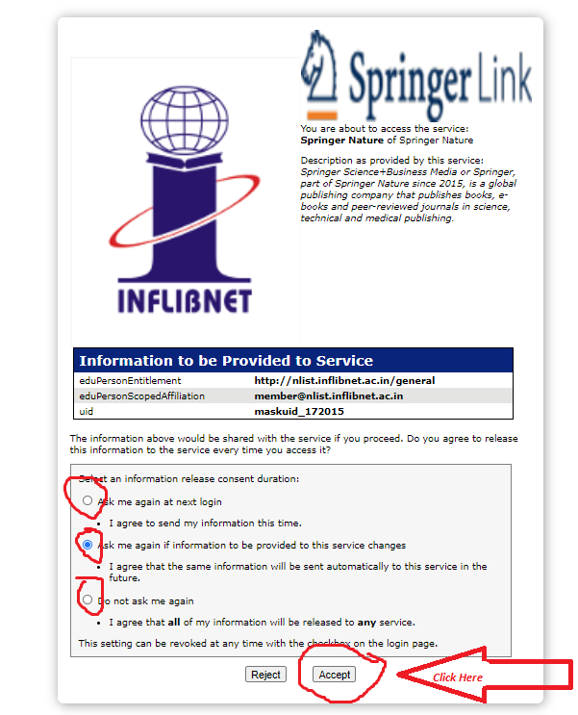
How to Access Information-4

Slide 10
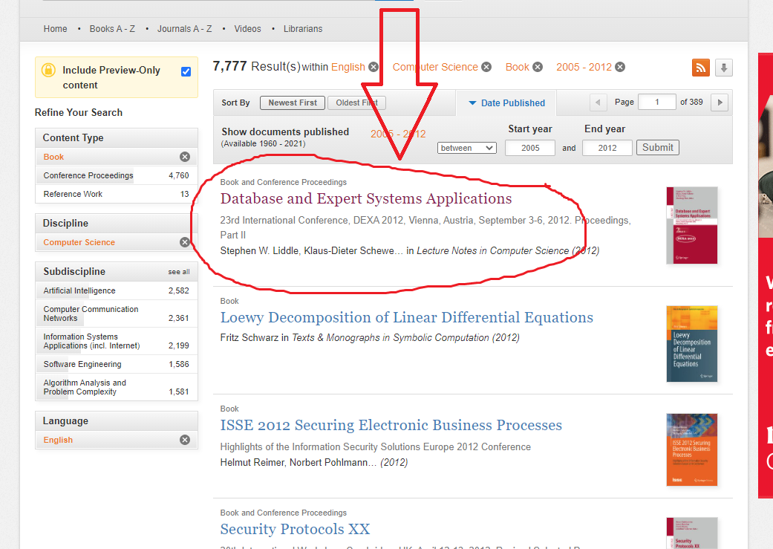
How to Access Information-5

Slide 11
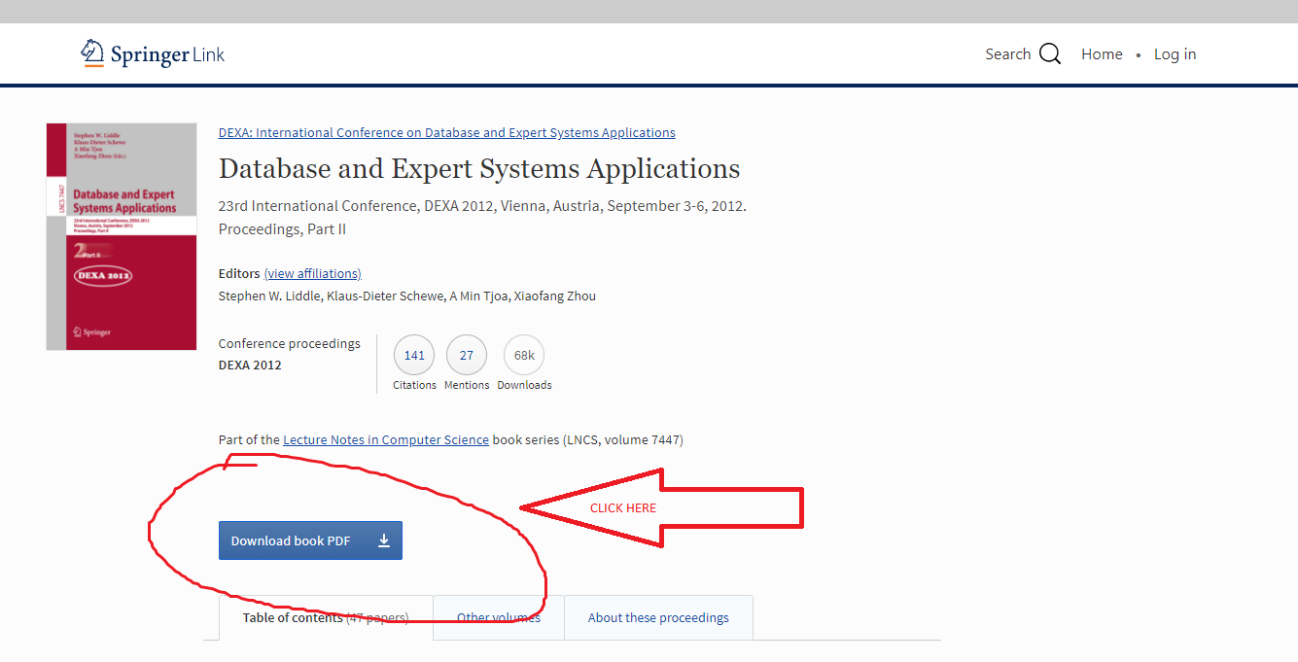
How to Access Information-6

Slide 12
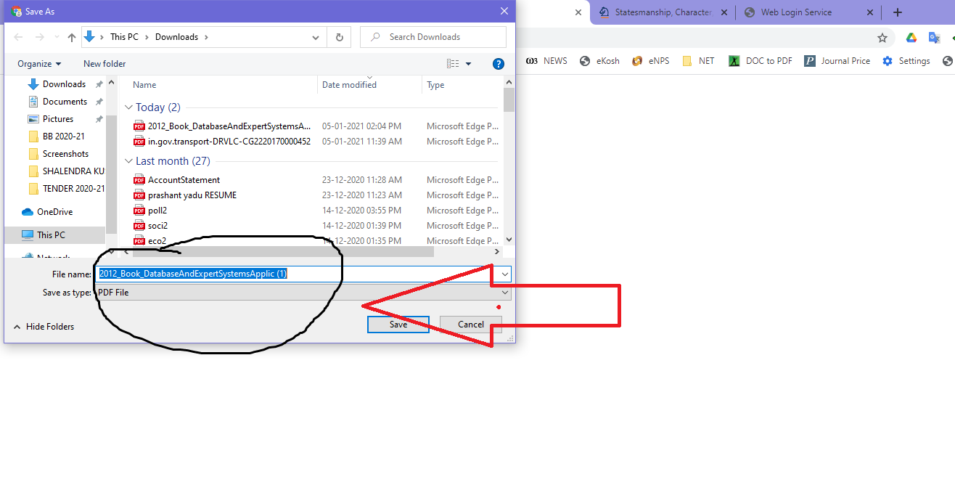
How to Access Information-7

Slide 13
Finally
Download completed
Thanking you very Much
For any assistance Contact to Library or write us to Shalendrakushwah@gmail.com

